Slide 1
A Framework for Data Science Projects: Recommendations and Pitfalls to Avoid
Ekrem Kocaguneli
10/29/2015

Slide 2
Before we begin…
A high level summary of a recent book chapter*
How to cover 40+ pages in ~30+ minutes
Reviewers also agree…
“One concern is the breadth of this topic. The talk is covering end-to-end problem solving at an introductory level. But some of the topics can be quite advanced.” – Reviewer #2
* The Art and Science of Analyzing Software Data, edited by Tim Menzies, Christian Bird, and Tom Zimmerman, 2015, Morgan Kaufmann

Slide 3
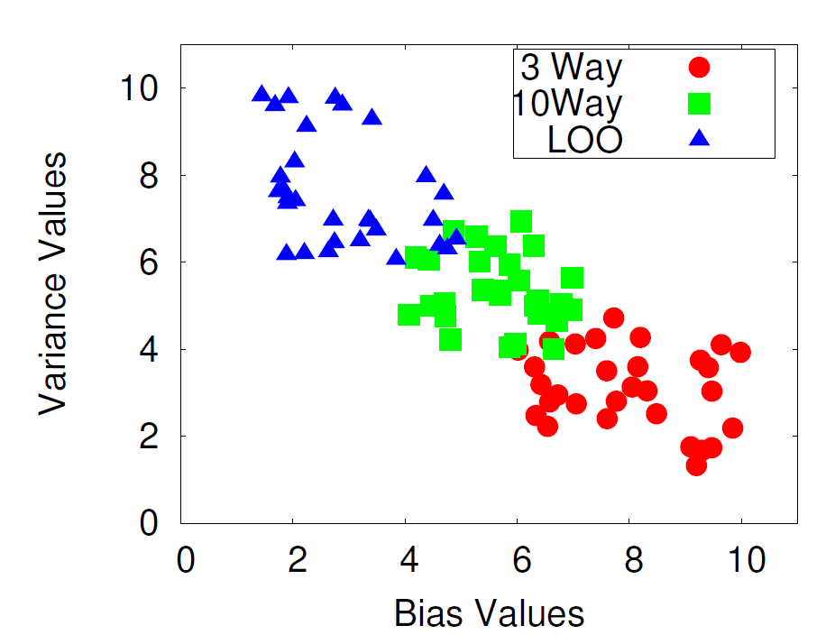
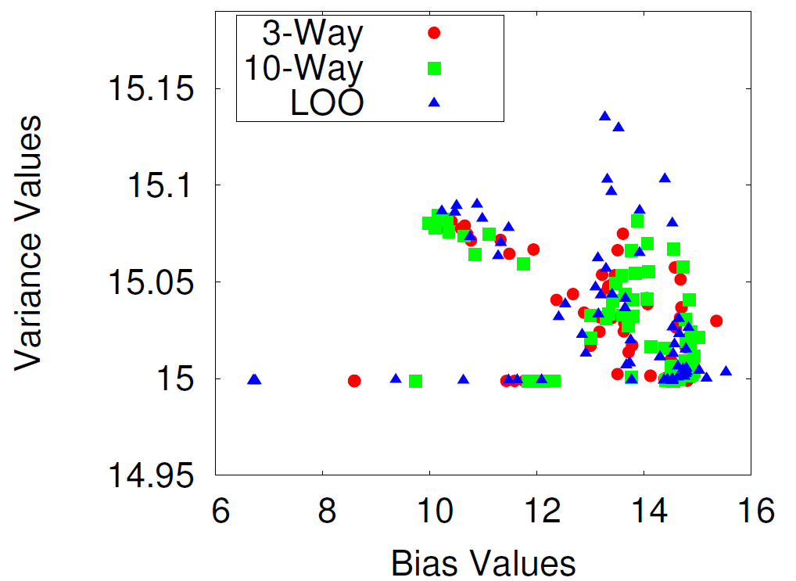
Alternatives are…
Bias & Variance implications of sampling techniques
Data
Domain knowledge
Objectives
Customer
Data Scientist
Business value
Expected
Actual
Too high level
Too Technical

Slide 4
Our aim is a blue-print of the whole process
Data
Domain knowledge
Objectives
Reflection on data science projects in retrospect to 10 years in 5 diverse organizations and in different problem cases reveal a generic framework
No digging too deep but rather a mapping of tools to big picture
Other sources for that e.g. “Toe Dipping into ML [8]” for ML intro or MS Machine Learning University [10]
Customer
Data Scientist
Business value
Problem
Selection
Data Extraction
Descriptive
Analytics
Predictive
Analytics
Specific and business-focused questions
Data sources and data health
Gaining insight into data
Predictions for future

Slide 5
1. Problem Selection
Problem
Selection
Data Extraction
Descriptive
Analytics
Predictive
Analytics
Specific and business-focused questions
Data sources and data health
Gaining insight into data
Predictions for future

Slide 6
1. Problem selection
Need to ask the right and important questions
Keep in mind: What is the relevance of this project’s outcome for practice?
From a previous case study: The development team’s objective is to improve development quality[1]. What is the expected value out of development quality for you?
Measured code quality, decreased defect rates, and less time to fix defects
The questions should be specific enough
E.g. a project’s business goal was “measuring release readiness of a software product“[2] Readiness in terms of what, based on which metrics?
Clarifications with dev leads and senior dev.s led to “post-release defect rate“
Post release defect rate required a predictive that needed metrics for requirements, design, development and testing

Slide 7
1. Problem selection
Pitfalls in understanding the problem
What is the target accuracy for the success of this project?
High accuracy is aimed, but depends on the available data
Good customer communication regarding accuracy and data relationship
Leaving the discussions open ended and making assumptions without iterative-validation
E.g. in a developer participation study, 10% of the developers seemed to develop 80-90% of code [11]
Assumption is that there are a few star dev.s the managers need to keep
Passing the assumption through dev.s revealed a different scenario
Gate-keeper dev.s, who collect code from dev branches and check-into production branch

Slide 8
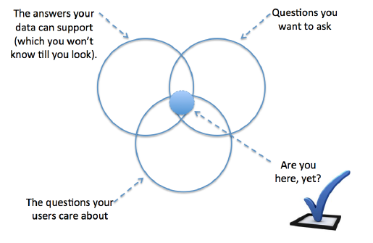
1. Problem selection
Figure from: Tim Menzies, Ekrem Kocaguneli, Burak Turhan, Leandro Minku, Fayola Peters, “Sharing Data and Models in Software Engineering” Elsevier / Morgan Kaufmann, 2014 (available through MSLibrary)

Slide 9
2. Data Extraction
Problem
Selection
Data Extraction
Descriptive
Analytics
Predictive
Analytics
Specific and business-focused questions
Data sources and data health
Gaining insight into data
Predictions for future

Slide 10
2. Data Extraction
Identify and prioritize data needs and sources
Taking data availability for granted (do you have the data? Of course, but …)
E.g. Dev and PM info, who worked in projects was missing or scattered in doc files
Identify and define appropriate metrics
Use previous literature to see similar metrics
Utilize metric definition ideas like GQM (goal, question, metric) approach [12]
1. Goal: Specify conceptual goals, e.g. improving release quality
2. Question: Characterize the objectives, e.g. what is the code-review model,
how good is the release?
3. Metric: A quantitative measure for question, e.g. average review count per check-in,
average post-release bug count per file and so on.

Slide 11
2. Data Extraction (cntd.)
Collect data through qualitative (survey, interview) and quantitative methods (mining repositories)
Possible pitfalls
Missing important domain knowledge or making false assumptions: e.g. Dll’s believed to be developed by single teams (for 80% of project duration), are in fact developed by multiple teams [13]
Involve as many domain experts as possible as early as possible

Slide 12
3. Descriptive Analytics
Problem
Selection
Data Extraction
Descriptive
Analytics
Predictive
Analytics
Specific and business-focused questions
Data sources and data health
Gaining insight into data
Predictions for future

Slide 13
3. Descriptive Analytics
Once data is collected, descriptive stats help gain an understanding of the data
Start with simple visualizations (plot instances of features, plot percentiles from 1 to 100)
Try box plots and histograms (to get a feeling of distribution)

Slide 14
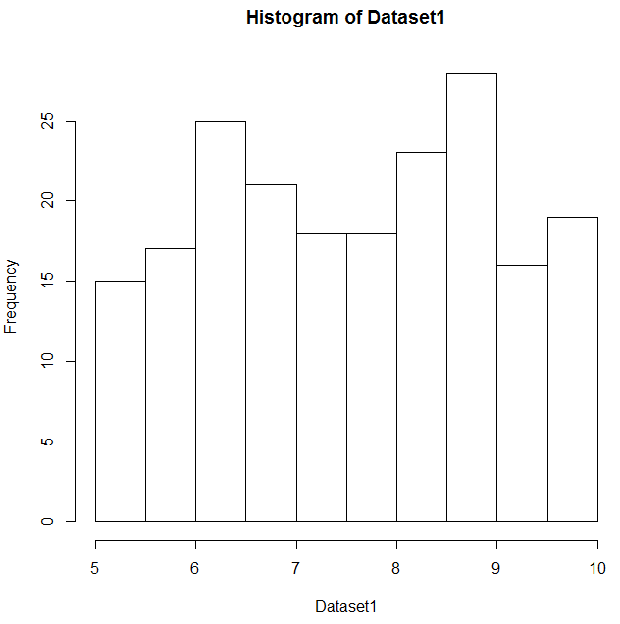
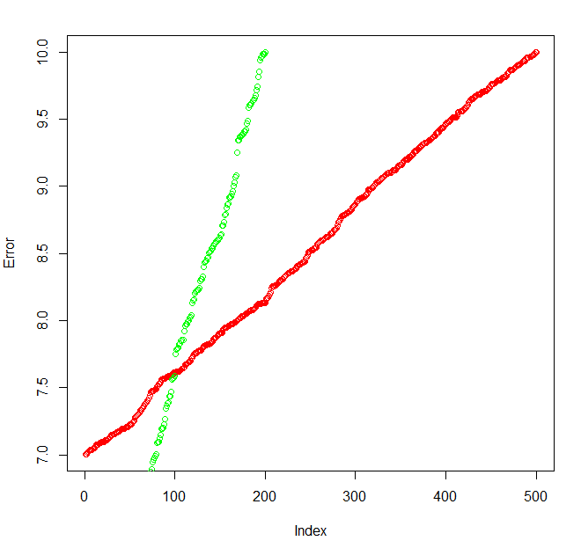
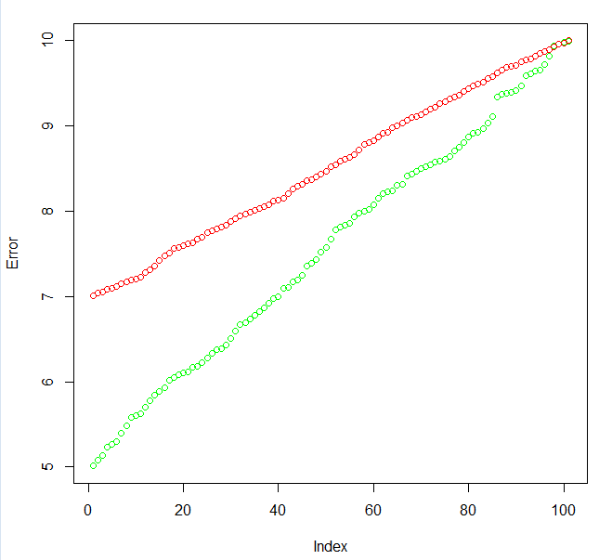
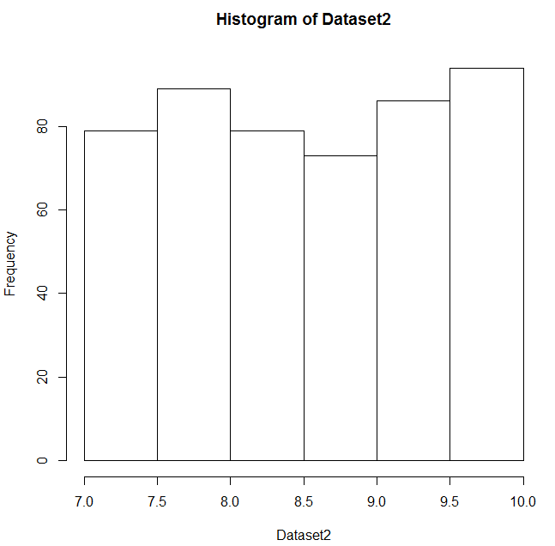
3. Descriptive Analytics (cntd.)
Let’s compare the error rates of an algorithm on 2 hypothetical datasets
Simple plot of errors on 2 different datasets with different sizes (200 vs 500 instances)
Percentiles from 0th to 100th
Histograms of errors

Slide 15
3. Descriptive Analytics (cntd.)
Box plot shows 0th-25th – 50th – 75th and 100th percentiles as well as outliers
25th to 75th percentile is called the interquartile-range
Outliers are more than 1.5*Interquartile range away from 25th and 75th percentiles
Outliers
100th Perc.
75th Perc.
50th Perc.
(Median)
25th Perc.
0th Perc.

Slide 16
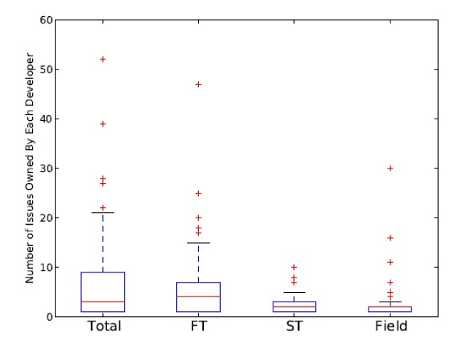
3. Descriptive Analytics (cntd.)
E.g. issues found by individual developers during (FT: functional testing, ST: system testing, Field: field testing [3]
See that most issues are found during functional testing
Also see that outliers in FT (48 issues found by single developer) either hint an outlier or too much reliance on individual developers

Slide 17
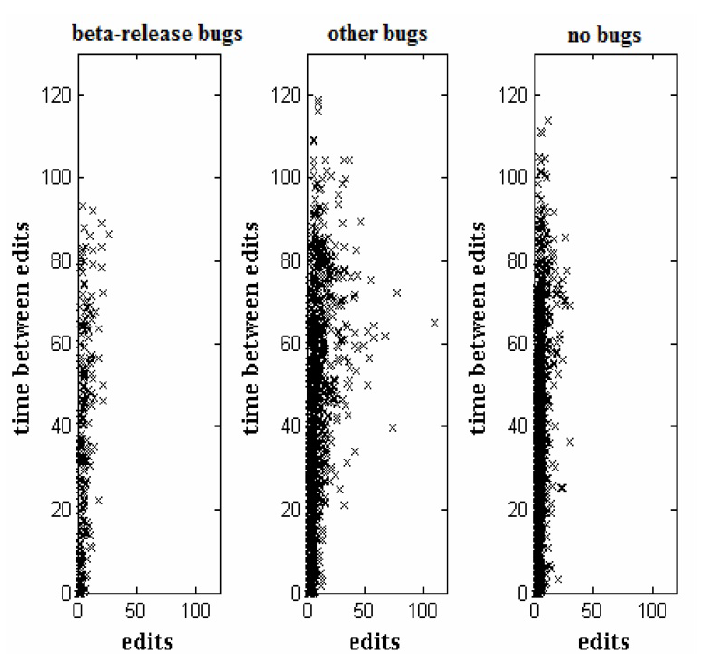
3. Descriptive Analytics (cntd.)
Scatterplots can be used to see relation between two variables
E.g. # of edits and time between edits on files with beta-release bugs vs others[4]
Not too much of a clear indication, but files with beta release bugs seem to have less # and less frequent edits

Slide 18
3. Descriptive Analytics (cntd.)
Deciding whether two populations are different
To decide between two competing methods, to decide if changing a factor has an effect etc.
Includes forming a null-hypothesis that we want to reject
Then picking an appropriate statistical test, which tells us if we can reject the null hypothesis
Appropriate test depends on the design of your experiment, see Chapter 10 of [6] for reference, which will be a discussion of the reference table below:
Design | Parametric | Non-parametric
One factor, one treatment |  | Chi-2, Binomial test
One factor, two treatments, completely randomized design | t-test, F-test | Mann-Whitney, Chi-2
One factor, two treatments, paired comparison | Paired t-test | Wilcoxon, Sign test
One factor, more than two treatments | ANOVA | Kruskal-Wallis
More than one factor | ANOVA

Slide 19
3. Descriptive Analytics (cntd.)
In an experiment, we have dependent and independent variables
e.g. development model (independent) and post-release bug count (dependent)
Experiment tries to understand the impact of changing an independent variable on the dependent variable, e.g. the effect of changing from waterfall to agile on post-release bugs
The changing independent variable is the factor and its particular values are treatments

Slide 20
3. Descriptive Analytics (cntd.)
Common Experiment Designs *
One factor two treatments
(e.g. does a new tool improve
code quality?)
One factor more than two treatments
(e.g. software quality when
using C# vs Python vs C++)
Randomized design
Subjects | Treatment 1 | Treatment 2
1 | X
2 |  | X
3 |  | X
4 | X
5 |  | X
6 | X
Paired design
Subjects | Treatment 1 | Treatment 2
1 | Second | First
2 | First | Second
3 | Second | First
4 | Second | First
5 | First | Second
6 | First | Second
Randomized design
Subjects | Treatment 1 | Treatment 2 | Treatment 3
1 |  | X
2 |  |  | X
3 | X
4 | X
5 |  | X
6 |  |  | X
Paired design
Subjects | Treatment 1 | Treatment 2 | Treatment 3
1 | First | Third | Second
2 | Third | First | Second
3 | Second | Third | First
4 | Second | First | Third
5 | Third | Second | First
6 | First | Second | Third
Figures are from [6]

Slide 21

3. Descriptive Analytics (cntd.)
Pitfall from Office 2010
For large populations stat. test may say that
populations are significantly different, but how big is the difference?
E.g. for Office 2010, we were interested in whether the distributed development has a negative impact on the development in terms of post-release bug counts [5]
Null hypothesis: Files developed by distributed and collocated teams have the same mean number of post-release bugs
Statistical test: The bug counts are significantly different
Decision: Should we avoid distributed development?
Effect size: How big is the effect?
Cohen’s and Hedge’s effect sizes [5]
As it turns out the size of the effect is small, hence although the distributed development is statistically significantly different from collocated development, the impact is negligible

Slide 22
4. Predictive Analytics
Problem
Selection
Data Extraction
Descriptive
Analytics
Predictive
Analytics
Specific and business-focused questions
Data sources and data health
Gaining insight into data
Predictions for future

Slide 23
4. Predictive Analytics
So now we have data, let’s define some terms…
Features and instances
Dependent and independent feature (label)
Regression and classification, based on the label being categorical or continuous
f1 | f2 | … | fn | label
i1 |  |  |  | defective
i2 |  |  |  | defective
… |  |  |  | …
in |  |  |  | Non-defective
Classification
i1 |  |  |  | 7
i2 |  |  |  | 5
… |  |  |  | 12
in |  |  |  | 17
Regression

Slide 24
4. Predictive Analytics
Learning from data
Learners (find relation from f_{i}’s to label)
Training and test sets (what about the future?)
Error measures (how well of a relation?)
f₁ | f₂ | … | f_{n}
label
Learner
Train data
Error Measure
f₁ | f₂ | … | f_{n}
i₁
I₂
…
i_{n}
label
Learner
Test data
f₁ | f₂ | … | f_{n}
Learner
prediction
label

Slide 25
4. Predictive Analytics (cntd.)
Toolbox
Linear regression
Logistic regression
Naïve Bayes
k-Nearest-Neighbors
Decision Trees
Neural Nets
Support vector machines
Ensembles
Details in ML Talks for beginners in Resnet[7]
Pitfalls
Make experiments repeatable: At any given step you may need to re-perform all experiments
E.g. the false assumption of dll independence revealed after 80% of the time was spent
Algorithms are not black-boxes
Understand assumptions
In SE the biggest variance in results comes from the research group conducting experiments [14]
In ensemble learning focus on a subset of successful learners [15]
Label | Type of Problem | Algorithms
Categorical (e.g. module defective or not) | Classification | Logistic regression, Naïve Bayes, k-NN, Decision Trees, Neural Nets, Ensembles
Continuous (e.g. number of defects) | Regression | Linear regression, k-NN, Decision Trees, Neural Nets, Ensembles

Slide 26
4. Predictive Analytics (cntd.)
What is the best machine learning algorithm? (from Quora)
Does your algorithm work for all prediction problems? (from a software development manager)
Understand each feature as they related to business and take a basic manual look (e.g. summary func. in R) to see weird stuff
E.g. “defect count” feature had negative or contradictory values, which may have gone unnoticed
Filter out outlier instances
Select relevant features
Sweep a set of learners with various parameters
Try alternative ideas like ensemble learning
Have answers to “why did you…?” or “why did the algorithm…?” type of questions
E.g. in a project aiming to predict how long the next project is going to take, the feature selection algorithm didn’t select “programmer capability”. This got an immediate “why?”

Slide 27
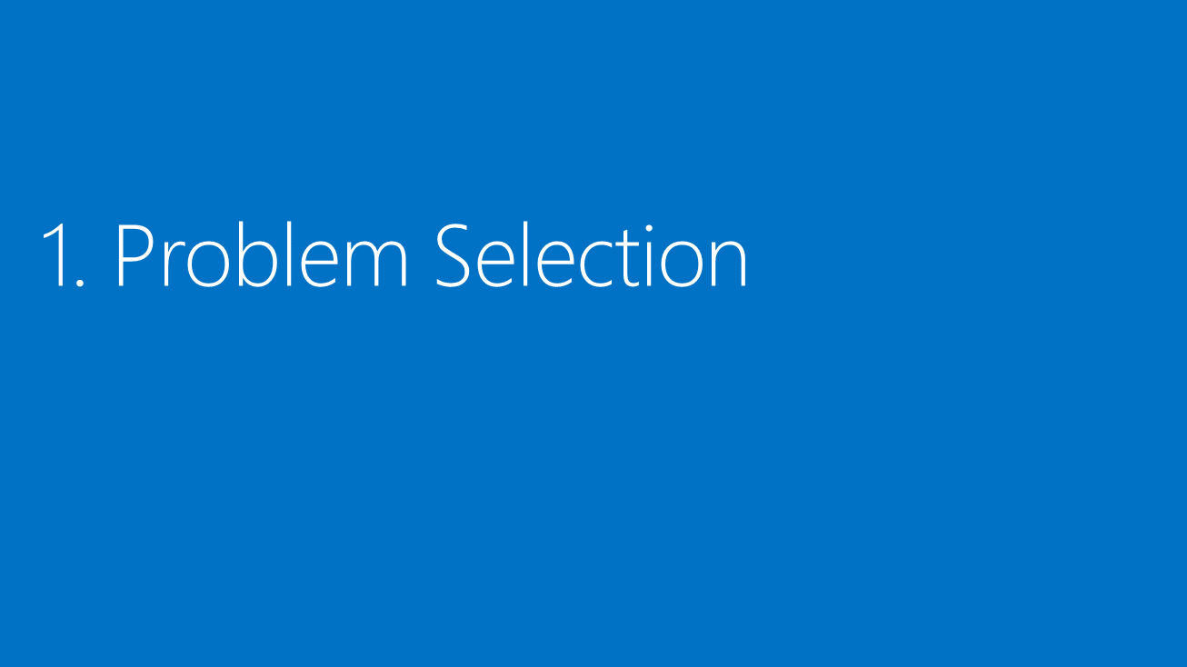
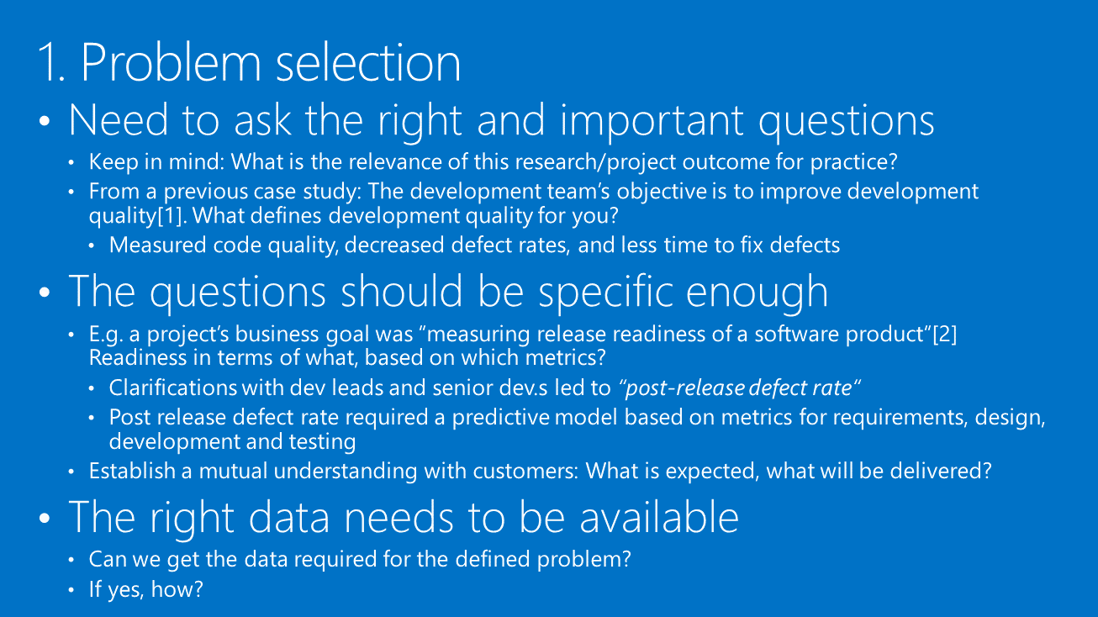
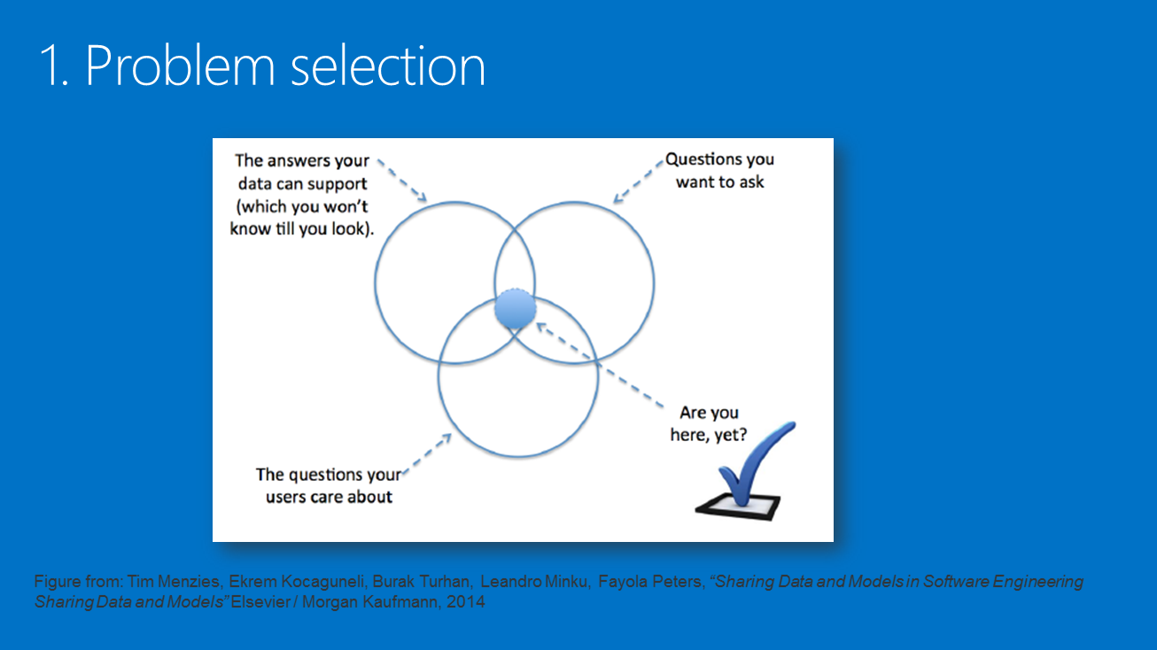
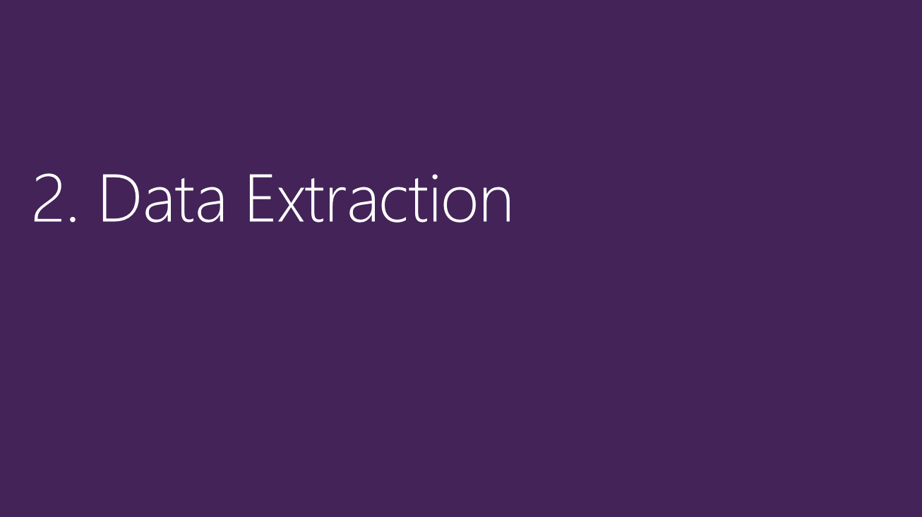
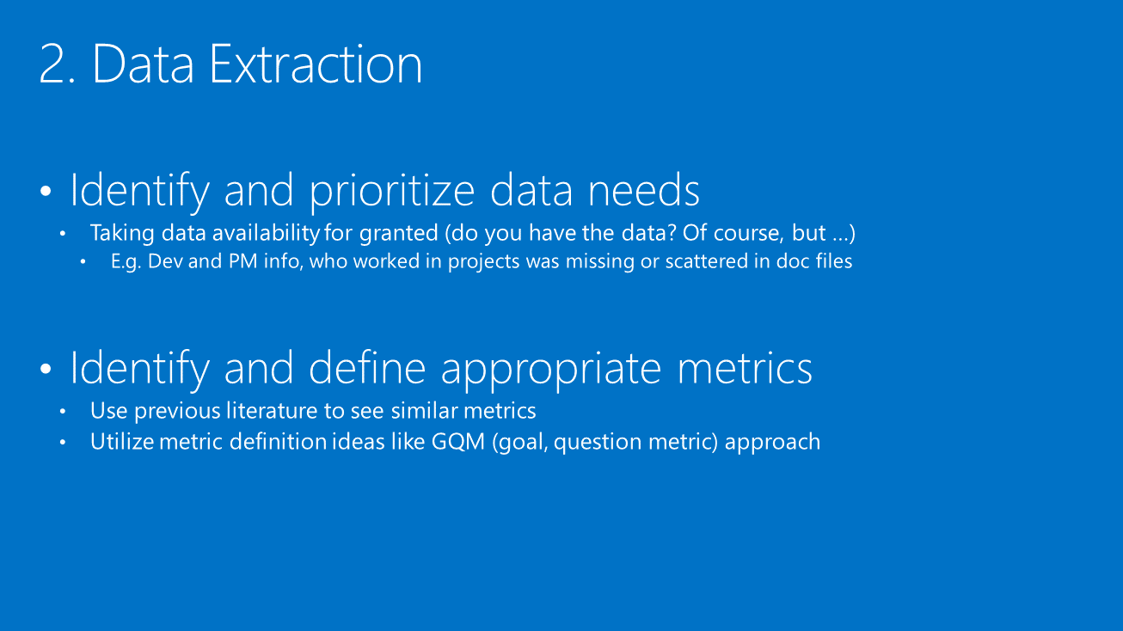
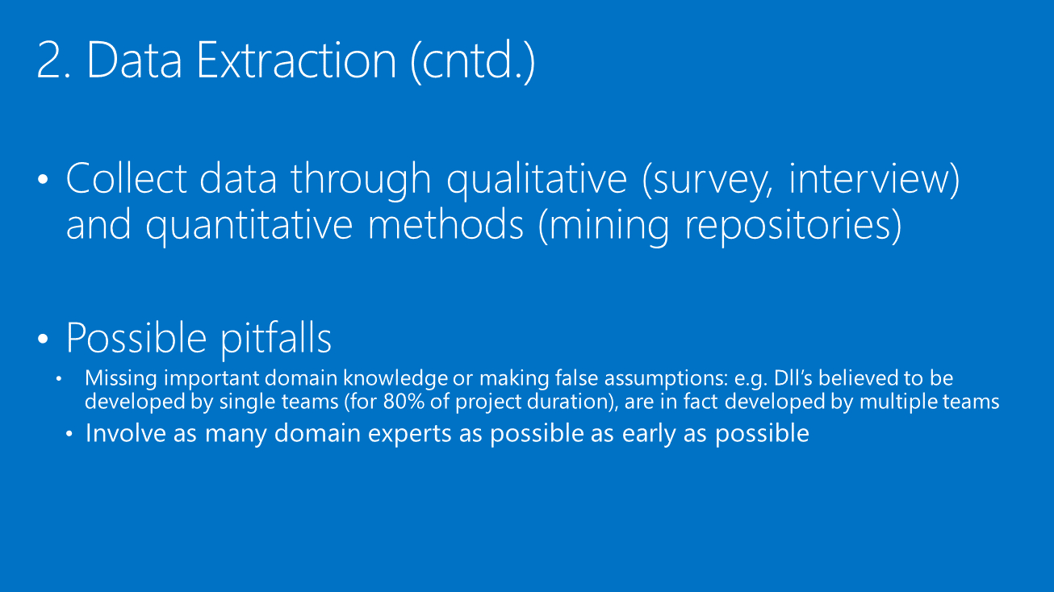
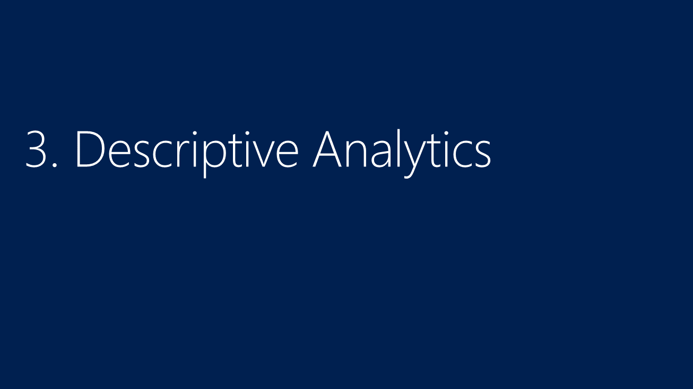
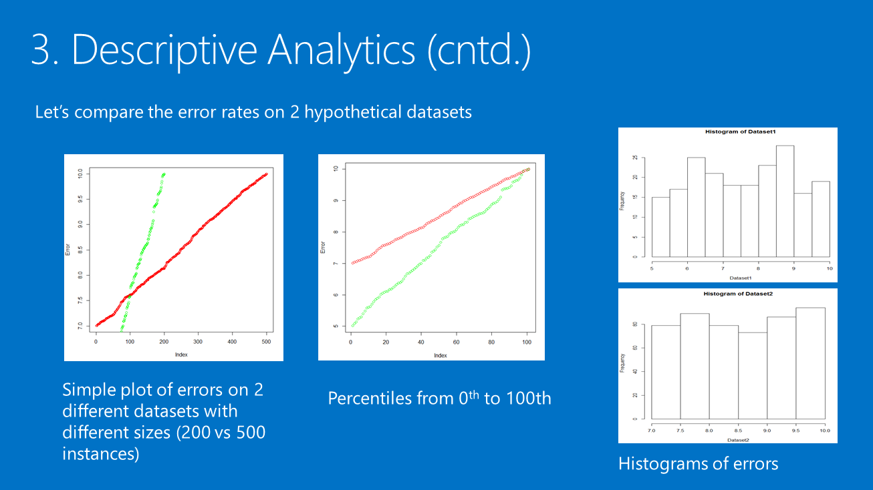
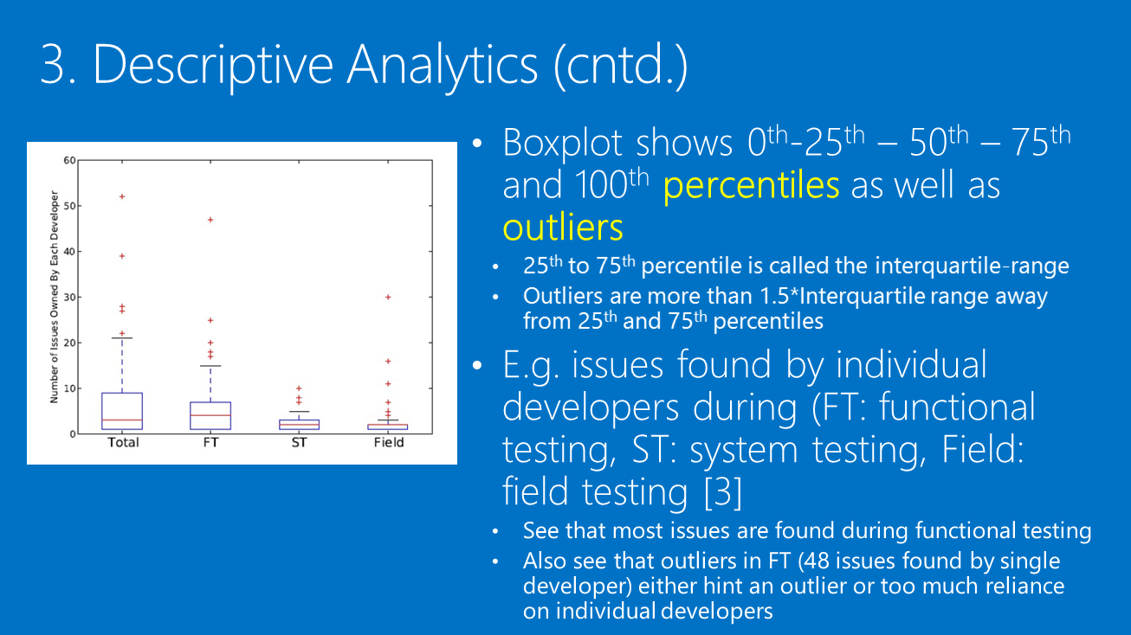
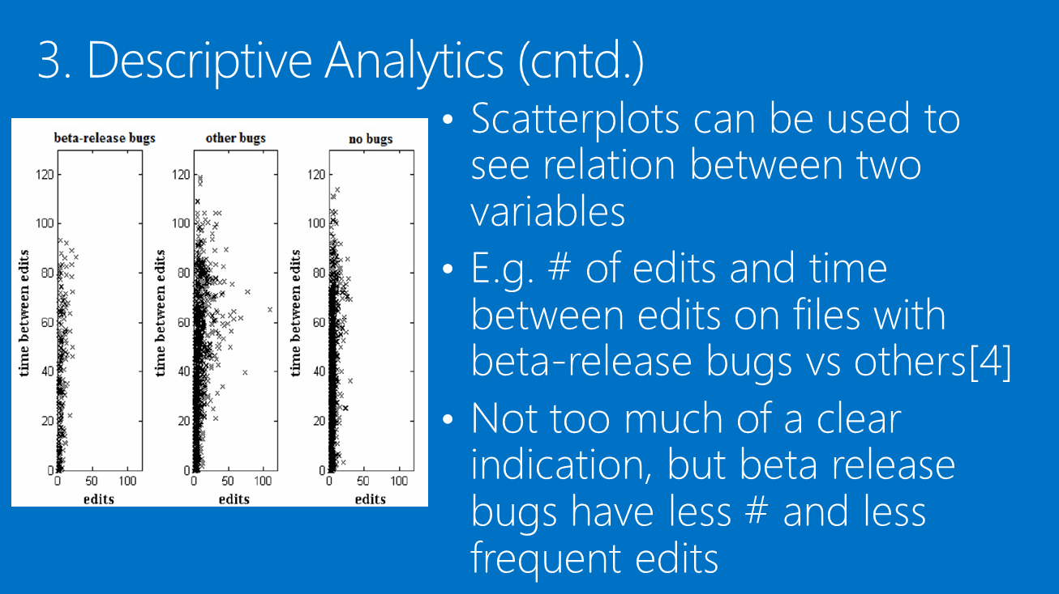
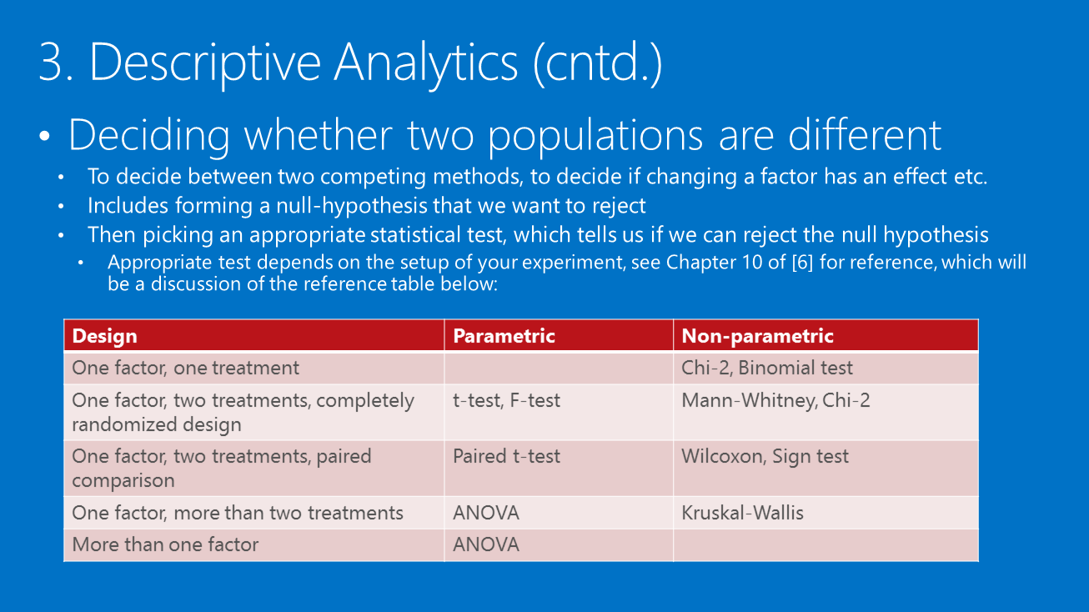
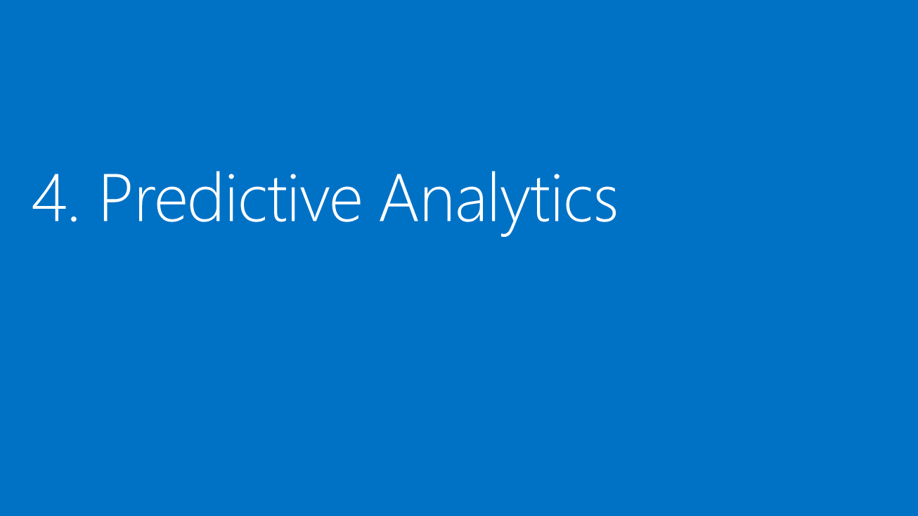
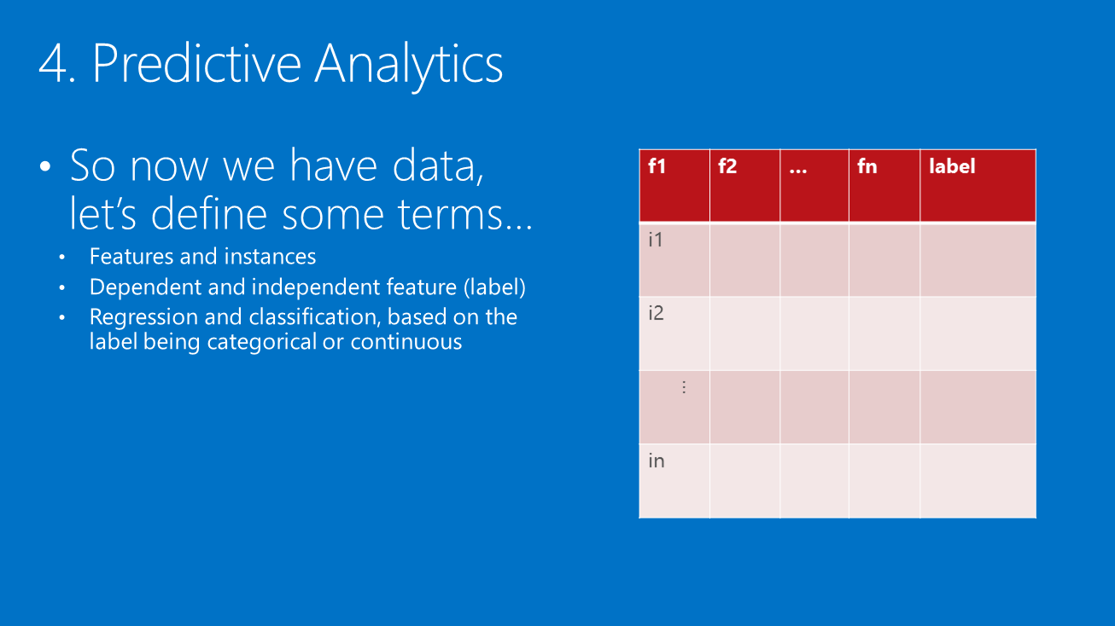
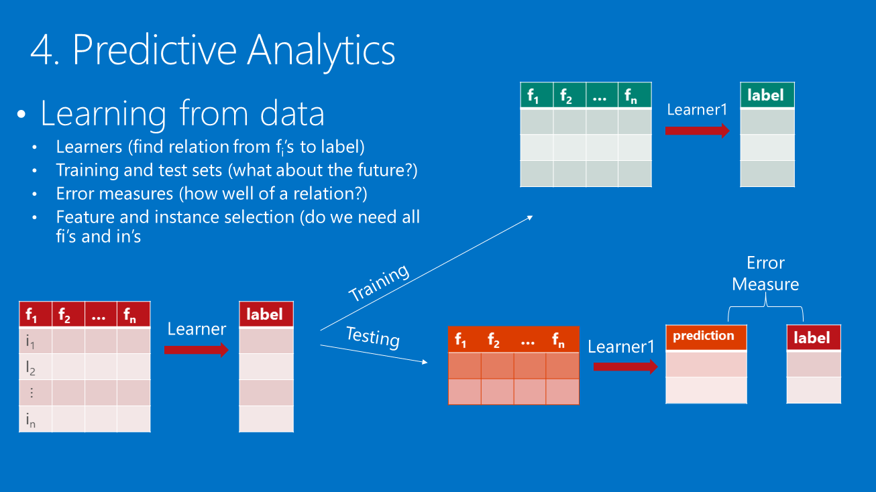
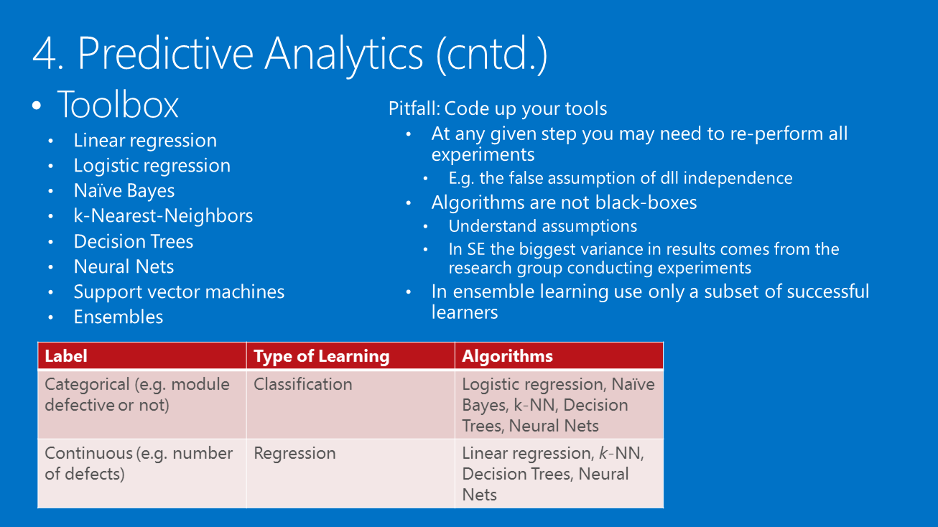
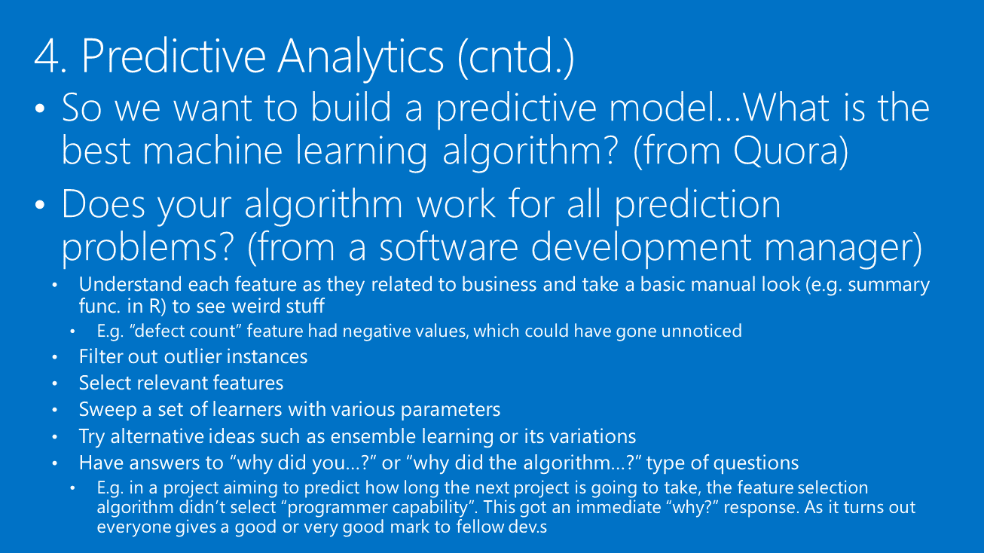
To sum up…
Problem
Selection
Data Extraction
Descriptive
Analytics
Predictive
Analytics
Specific and business-focused questions
Data sources and data health
Gaining insight into data
Predictions for future

Slide 28
References
[1] A. Tosun, A. B. Bener, B. Turhan, T. Menzies, Practical considerations in deploying statistical methods for defect prediction: A case study within the turkish telecommunications industry, Information and Software Technology 52 (11) (2010) 1242{1257.
[2] A. T. Misirli, A. Bener, Bayesian networks for evidence-based decision making in software engineering, IEEE Trans. Softw. Eng. 40 (2014) 533-554.
[3] B. Caglayan, A. Bener, Issue ownership activity in two large software projects, in: 9th International Workshop on Software Quality, collocated with FSE, 2012.
[4] A. T. Misirli, B. Murphy, T. Zimmermann, A. Bener, An explanatory analysis on eclipse beta-release bugs through in-process metrics, in: 8th International workshop on software quality, ACM, 2011, pp. 26-33.
[5] Kocaguneli, Ekrem, Thomas Zimmermann, Christian Bird, Nachiappan Nagappan, and Tim Menzies. "Distributed development considered harmful?." In Software Engineering (ICSE), 2013 35th International Conference on, pp. 882-890. IEEE, 2013.
[6] Wohlin, Claes, Per Runeson, Martin Höst, Magnus C. Ohlsson, Björn Regnell, and Anders Wesslén. Experimentation in software engineering. Springer Science & Business Media, 2012.
[7] MS Intro to ML Talks: http://resnet/myresnet.aspx?_cn=RESNET&spid=8318c8d3-ea62-4e3c-8555-4dd67c5b489d
[8] Toe-dipping into ML: http://resnet/RESNET/fullvideo.aspx?id=33960&playlist=8318c8d3-ea62-4e3c-8555-4dd67c5b489d
[10] MS Machine Learning University: http://codebox/ml
[11] Kocaguneli, Ekrem, Ayse Tosun Misirli, Bora Caglayan, and Ayse Bener. "Experiences on developer participation and effort estimation." In Software Engineering and Advanced Applications (SEAA), 2011 37th EUROMICRO Conference on, pp. 419-422. IEEE, 2011.
[12] Nagappan, Nachiappan, Brendan Murphy, and Victor Basili. "The influence of organizational structure on software quality: an empirical case study." InProceedings of the 30th international conference on Software engineering, pp. 521-530. ACM, 2008.
[13] Kocaguneli, Ekrem, Ayse Tosun, and Ayse Bener. "AI-based models for software effort estimation." In Software Engineering and Advanced Applications (SEAA), 2010 36th EUROMICRO Conference on, pp. 323-326. IEEE, 2010.
[14] Menzies, Tim, and Martin Shepperd. "Special issue on repeatable results in software engineering prediction." Empirical Software Engineering 17, no. 1 (2012): 1-17.
[15] Kocaguneli, Ekrem, Tim Menzies, and Jacky W. Keung. "On the value of ensemble effort estimation." Software Engineering, IEEE Transactions on 38, no. 6 (2012): 1403-1416.

Slide 29
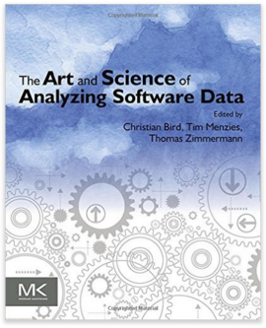

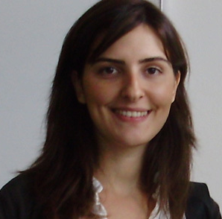





Co-authors
Ayse Tosun
Istanbul Technical University
Turkey
Bora Caglayan
Ryerson University, CA
Gul Calikli
Open University, UK
Ayse B. Bener
Ryerson University, CA
Editors
Tim Menzies
NC State, USA
Christian Bird
MSR, USA
Thomas Zimmermann
MSR, USA

Slide 30


